Slide 1
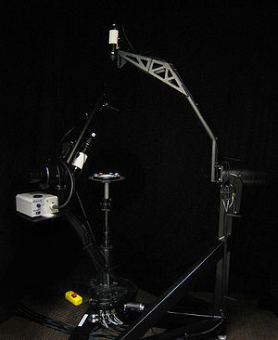
Stochastic Rendering Techniques
http://en.wikipedia.org/wiki/Gonioreflectometer
Dave Kilian, John F. Hughes
12/3/2012

Slide 2
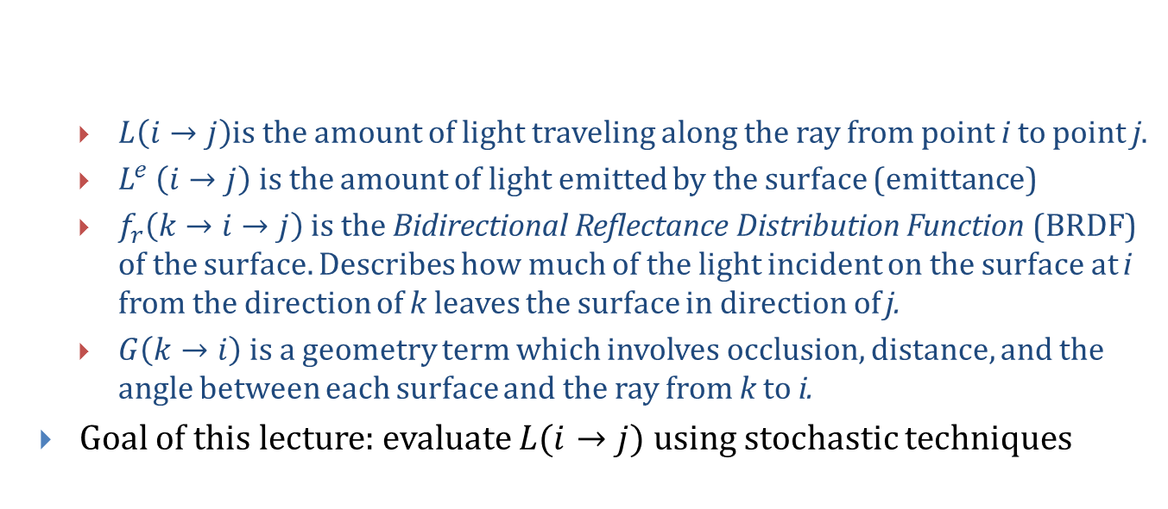
Review: Kajiya’s Rendering Equation
$L\left(i→j\right)$is the amount of light traveling along the ray from point i to point j.
$L^{e}$ $\left(i→j\right)$ is the amount of light emitted by the surface (emittance)
$f_{r}\left(k→i→j\right)$ is the Bidirectional Reflectance Distribution Function (BRDF) of the surface. Describes how much of the light incident on the surface at i from the direction of k leaves the surface in direction of j.
$G\left(k→i\right)$is a geometry term which involves occlusion, distance, and the angle between each surface and the ray from k to i.
Goal of this lecture: evaluate $L(i→j)$ using stochastic techniques
¹J Kajiya. “The Rendering Equation.” SIGGRAPH 1986, pp. 143-150

Slide 3

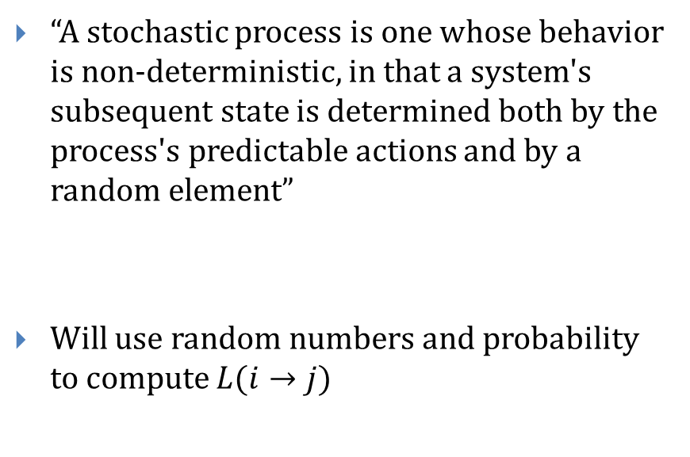
Stochastic Methods
“A stochastic process is one whose behavior is non-deterministic, in that a system's subsequent state is determined both by the process's predictable actions and by a random element”
Will use random numbers and probability to compute $L(i→j)$
– http://en.wikipedia.org/wiki/Stochastic
http://sp.life123.com/bm.pix/probability1.s600x600.jpg

Slide 4
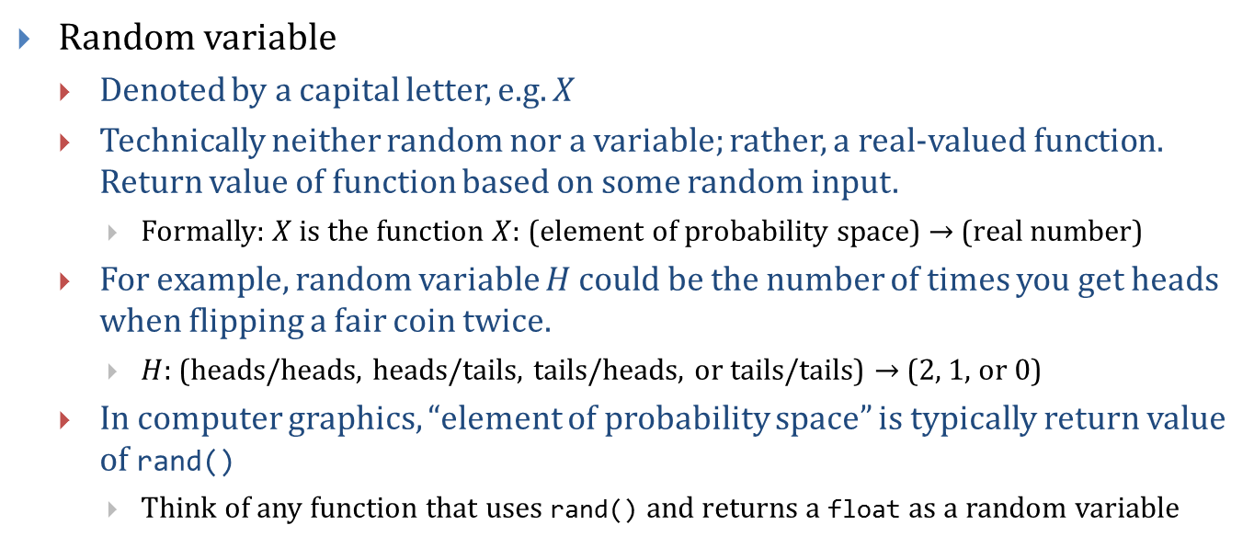
Basic Probability Refresher (1/7)
Random variable
Denoted by a capital letter, e.g. $X$
Technically neither random nor a variable; rather, a real-valued function. Return value of function based on some random input.
Formally: $X$ is the function $X:$ (element of probability space) $→$ (real number)
For example, random variable $H$ could be the number of times you get heads when flipping a fair coin twice.
$H:$ (heads/heads, heads/tails, tails/heads, or tails/tails) $→$ (2, 1, or 0)
In computer graphics, “element of probability space” is typically return value of rand()
Think of any function that uses rand() and returns a float as a random variable

Slide 5
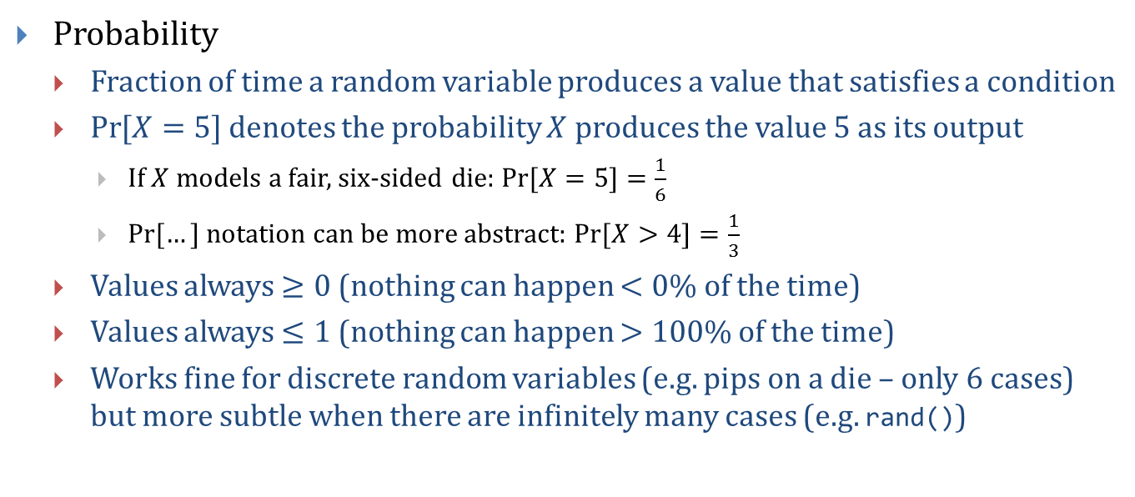
Basic Probability Refresher (2/7)
Probability
Fraction of time a random variable produces a value that satisfies a condition
$\operatorname{Pr}{[X=5]}$ denotes the probability $X$ produces the value 5 as its output
If $X$ models a fair, six-sided die: $\operatorname{Pr}{[X=5]}=\frac{1}{6}$
$Pr⁡[…]$ notation can be more abstract: $\operatorname{Pr}{[X>4]}=\frac{1}{3}$
Values always $≥0$ (nothing can happen $<0\%$ of the time)
Values always $≤1$ (nothing can happen $>100\%$ of the time)
Works fine for discrete random variables (e.g. pips on a die – only 6 cases) but more subtle when there are infinitely many cases (e.g. rand())

Slide 6
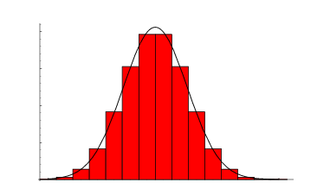
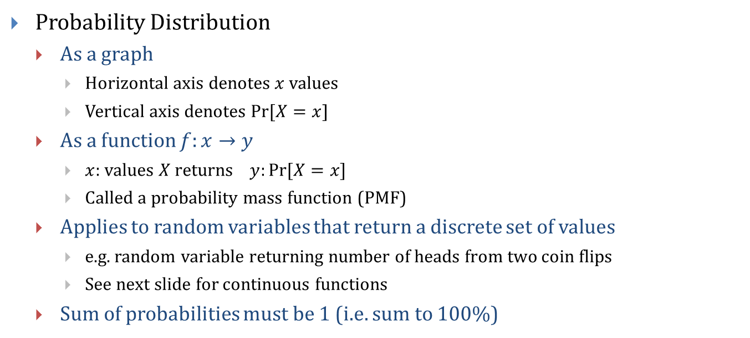
Basic Probability Refresher (3/7)
Probability Distribution
As a graph
Horizontal axis denotes $x$ values
Vertical axis denotes $Pr⁡[X=x$]
As a function $f:x→y$
$x$: values $X$ returns $y:Pr[X=x]$
Called a probability mass function (PMF)
Applies to random variables that return a discrete set of values
e.g. random variable returning number of heads from two coin flips
See next slide for continuous functions
Sum of probabilities must be 1 (i.e. sum to 100%)
Discrete Gaussian Distribution
Values near the center are more likely
http://mathworld.wolfram.com/images/eps-gif/BinomialGaussian_1000.gif

Slide 7
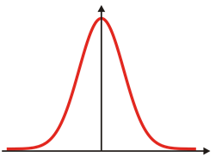
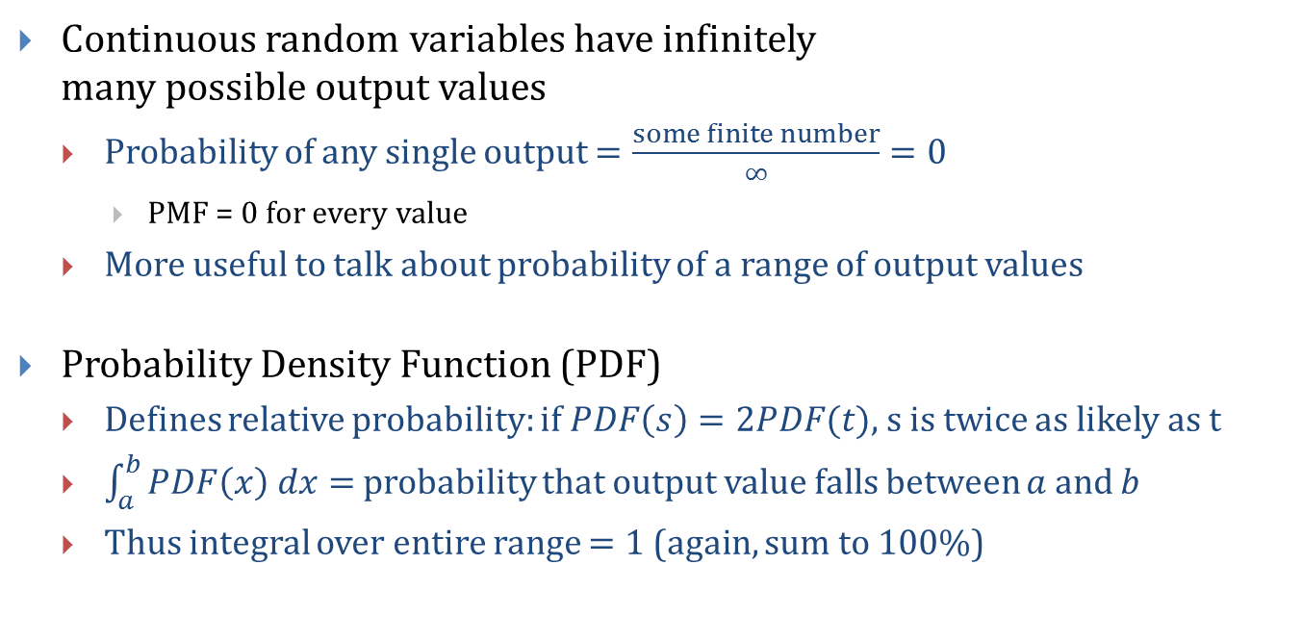
Basic Probability Refresher (4/7)
Continuous random variables have infinitely many possible output values
Probability of any single output $=\frac{some finite number}{∞}=0$
PMF = 0 for every value
More useful to talk about probability of a range of output values
Probability Density Function (PDF)
Defines relative probability: if $PDF\left(s\right)=2PDF(t)$, s is twice as likely as t
$\int_{a}^{b}{PDF\left(x\right) dx= }$probability that output value falls between $a$ and $b$
Thus integral over entire range $=1$ (again, sum to 100%)
Continuous Gaussian Distribution
Values near the center are more likely

Slide 8
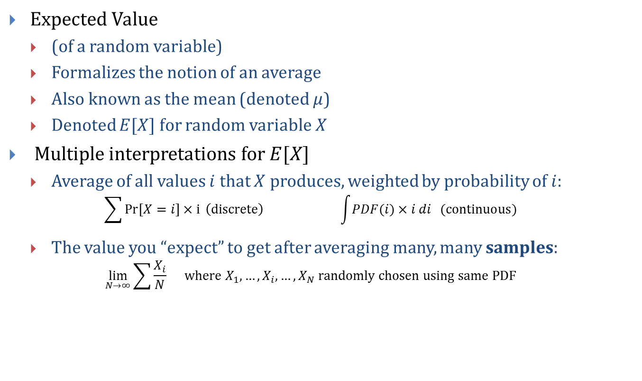
Basic Probability Refresher (5/7)
Expected Value
(of a random variable)
Formalizes the notion of an average
Also known as the mean (denoted $μ$)
Denoted $E[X]$ for random variable $X$
Multiple interpretations for $E[X]$
Average of all values $i$ that $X$ produces, weighted by probability of $i$: $\sum{Pr[X=i]×i} \left(discrete\right) \int{PDF(i)×i di } (continuous)$
The value you “expect” to get after averaging many, many samples: $\lim_{N→∞}\sum{\frac{X_{i}}{N}} where X_{1},…, X_{i}, …, X_{N} randomly chosen using same PDF$

Slide 9
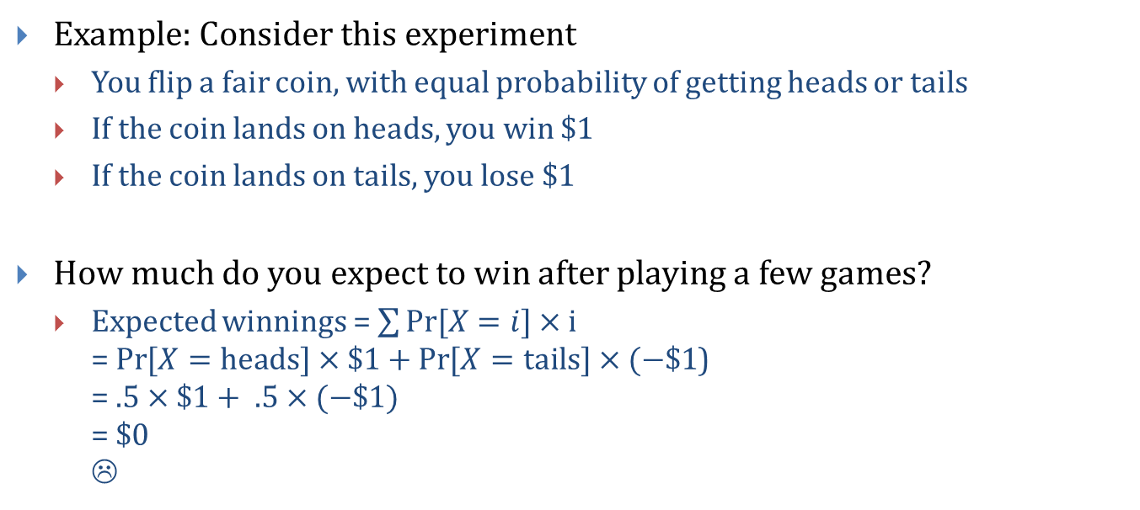
Basic Probability Refresher (6/7)
Example: Consider this experiment
You flip a fair coin, with equal probability of getting heads or tails
If the coin lands on heads, you win $1
If the coin lands on tails, you lose $1
How much do you expect to win after playing a few games?
Expected winnings = $\sum{Pr[X=i]×i}$ = $\operatorname{Pr}{[X=heads]}×\$1+\operatorname{Pr}{[X=tails]}×(−\$1$) = $.5×\$1+ .5×(−\$1)$ = $0 ☹

Slide 10
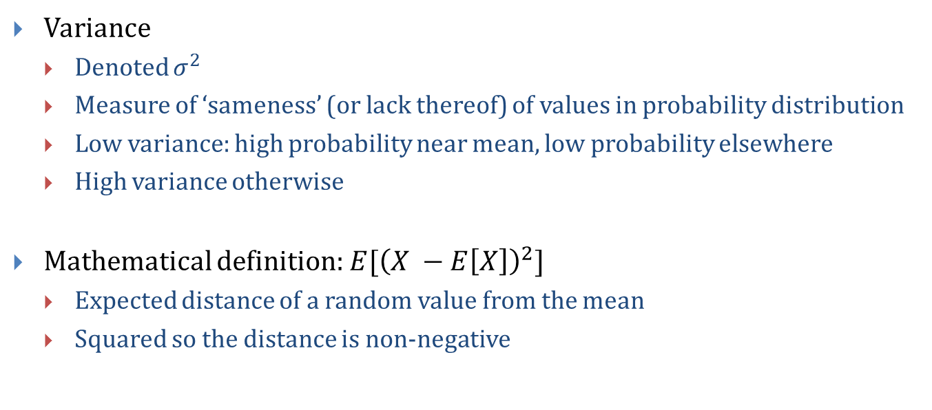
Basic Probability Refresher (7/7)
Variance
Denoted $σ^{2}$
Measure of ‘sameness’ (or lack thereof) of values in probability distribution
Low variance: high probability near mean, low probability elsewhere
High variance otherwise
Mathematical definition: $E[{\left(X −E\left[X\right]\right)}^{2}]$
Expected distance of a random value from the mean
Squared so the distance is non-negative

Slide 11
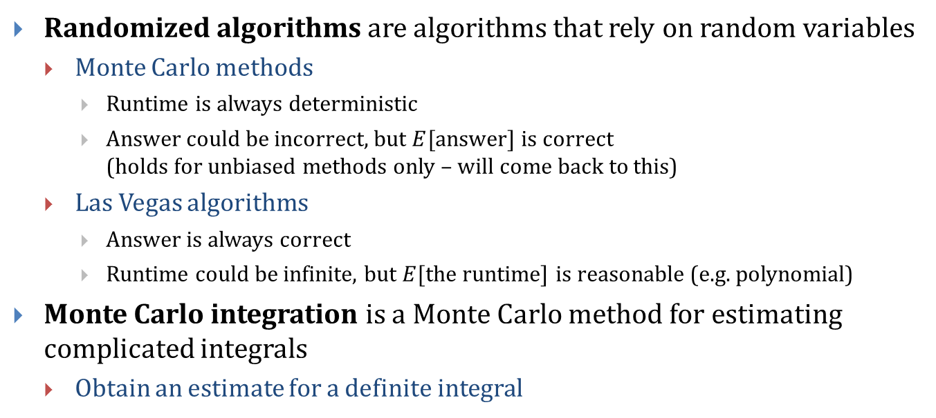
Monte Carlo Techniques
Randomized algorithms are algorithms that rely on random variables
Monte Carlo methods
Runtime is always deterministic
Answer could be incorrect, but $E[$answer$]$ is correct (holds for unbiased methods only – will come back to this)
Las Vegas algorithms
Answer is always correct
Runtime could be infinite, but $E[$the runtime$]$ is reasonable (e.g. polynomial)
Monte Carlo integration is a Monte Carlo method for estimating complicated integrals
Obtain an estimate for a definite integral

Slide 12
History: Monte Carlo Method
The Monte Carlo method was coined in the 1940s by John von Neumann, Stanislaw Ulam and Nicholas Metropolis, while they were working on nuclear weapon projects (Manhattan Project) in the Los Alamos National Laboratory.
It was named after the Monte Carlo Casino, a famous casino where Ulam's uncle often gambled away his money.
http://en.wikipedia.org/wiki/Monte_Carlo_method

Slide 13
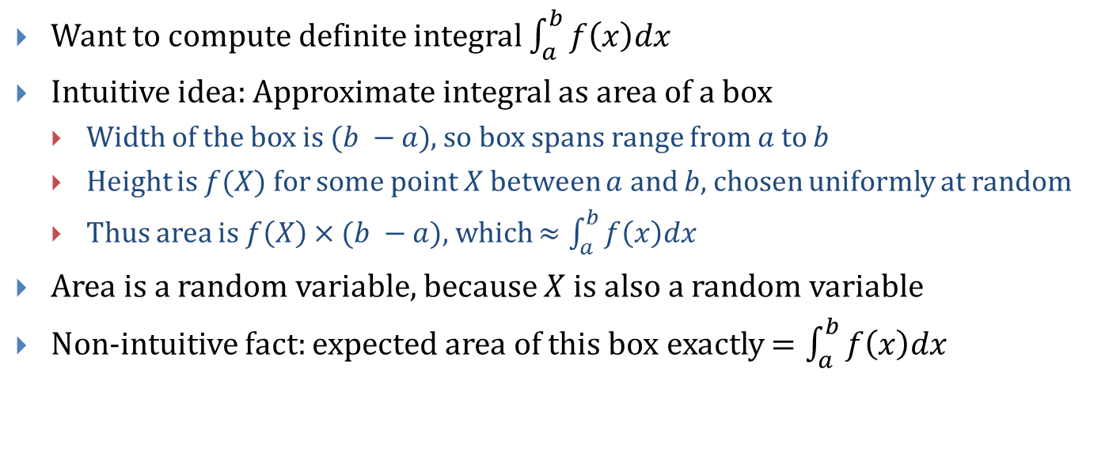
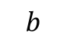
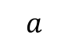
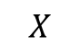
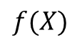
Monte Carlo Integration (1/8)
Want to compute definite integral $\int_{a}^{b}{f\left(x\right)dx}$
Intuitive idea: Approximate integral as area of a box
Width of the box is $(b −a)$, so box spans range from $a$ to $b$
Height is $f(X)$ for some point $X$ between $a$ and $b$, chosen uniformly at random
Thus area is $f\left(X\right)×(b −a)$, which $≈\int_{a}^{b}{f\left(x\right)dx}$
Area is a random variable, because $X$ is also a random variable
Non-intuitive fact: expected area of this box exactly $=\int_{a}^{b}{f\left(x\right)dx}$
$$f(X)$$
$$a$$
$$X$$
$$b$$

Slide 14
Monte Carlo Integration (2/8)
Quality of a single approximation varies
Good
Fair
Poor

Slide 15
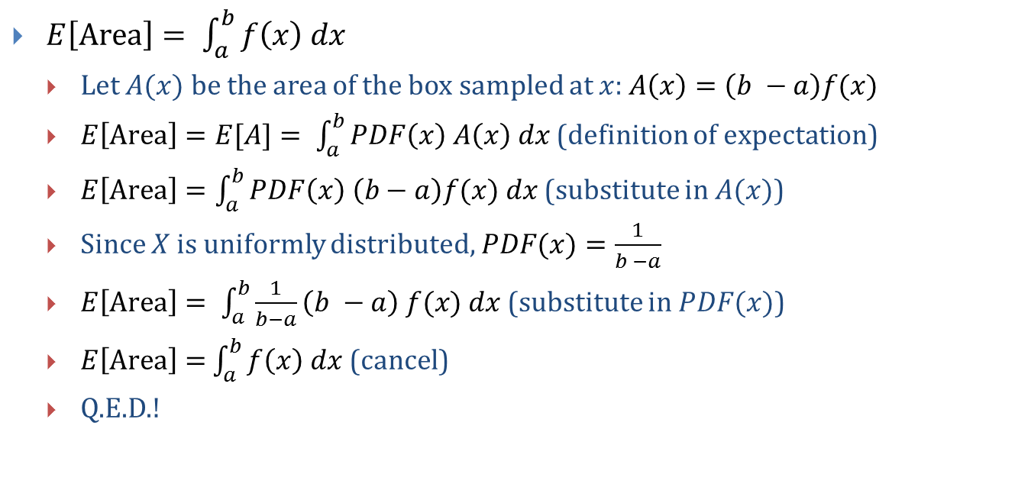
Monte Carlo Integration (3/8)
$E\left[Area\right]= \int_{a}^{b}{f\left(x\right) dx}$
Let $A(x)$ be the area of the box sampled at $x$: $A\left(x\right)=\left(b −a\right)f(x)$
$E\left[Area\right]=E[A]= \int_{a}^{b}{PDF\left(x\right) A\left(x\right) dx}$ (definition of expectation)
$E\left[Area\right]=\int_{a}^{b}{PDF\left(x\right) \left(b−a\right)f(x) dx}$ (substitute in $A(x)$)
Since $X$ is uniformly distributed, $PDF(x)=\frac{1}{b −a}$
$E\left[Area\right]= \int_{a}^{b}{\frac{1}{b−a}\left(b −a\right) f(x) dx}$ (substitute in $PDF(x)$)
$E\left[Area\right]=$ $\int_{a}^{b}{f\left(x\right) dx}$ (cancel)
Q.E.D.!

Slide 16
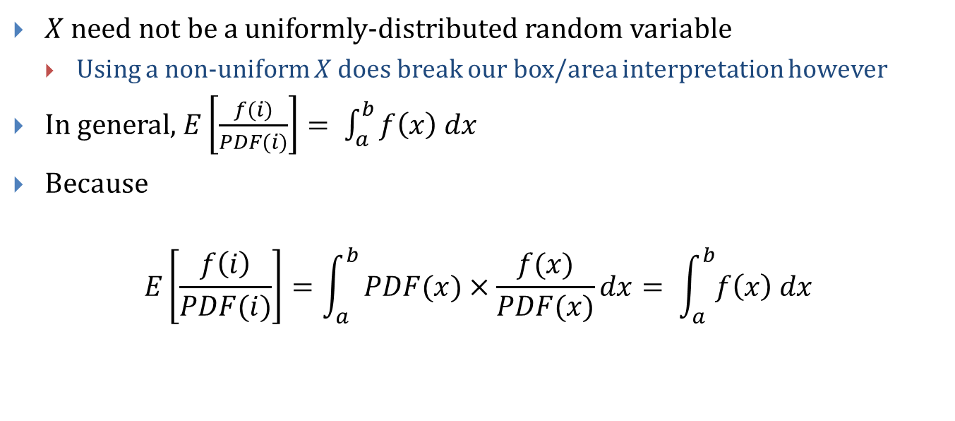
Monte Carlo Integration (4/8)
$X$ need not be a uniformly-distributed random variable
Using a non-uniform $X$ does break our box/area interpretation however
In general, $E\left[\frac{f(i)}{PDF(i)}\right]= \int_{a}^{b}{f\left(x\right) dx}$
Because
$$E\left[\frac{f\left(i\right)}{PDF(i)}\right]=\int_{a}^{b}{PDF(x)×\frac{f(x)}{PDF(x)}dx}= \int_{a}^{b}{f\left(x\right) dx}$$

Slide 17
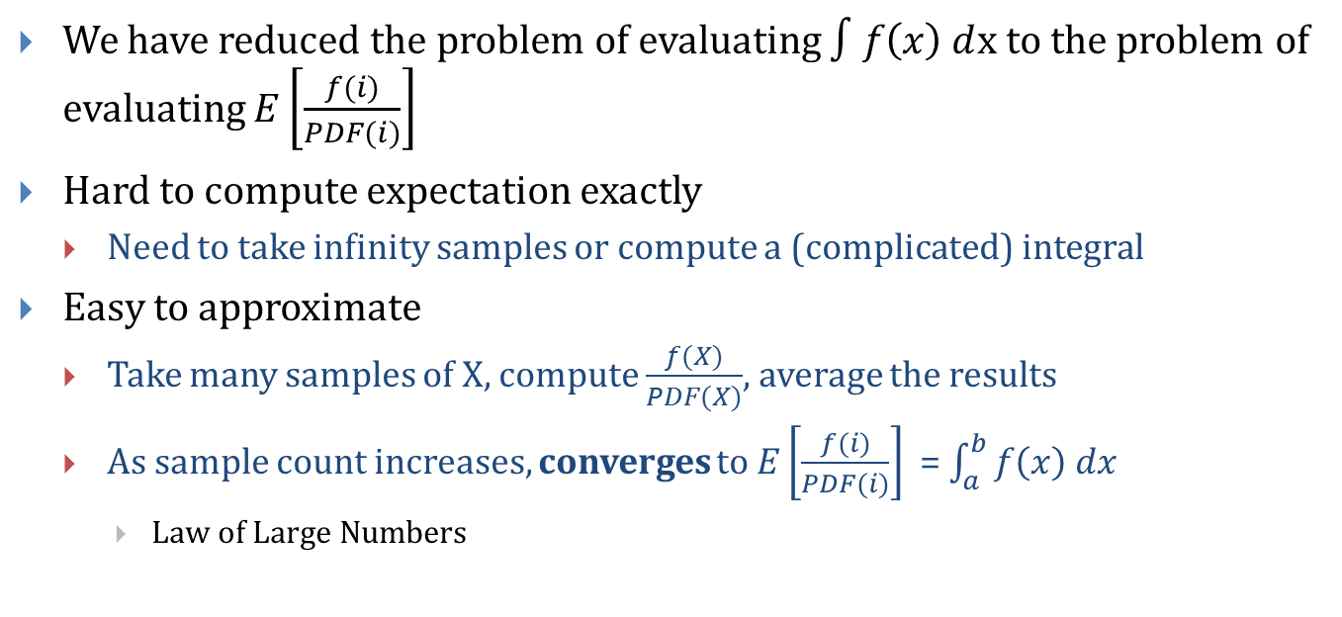
Monte Carlo Integration (5/8)
We have reduced the problem of evaluating $∫f\left(x\right) d$x to the problem of evaluating $E\left[\frac{f(i)}{PDF(i)}\right]$
Hard to compute expectation exactly
Need to take infinity samples or compute a (complicated) integral
Easy to approximate
Take many samples of X, compute $\frac{f(X)}{PDF(X)}$, average the results
As sample count increases, converges to $E\left[\frac{f(i)}{PDF⁡(i)}\right]$ = $\int_{a}^{b}{f\left(x\right) dx}$
Law of Large Numbers

Slide 18
Monte Carlo Integration (6/8)
Pseudocode N := (large number) result := 0 for (n := 0; n < N; ++n) X = random(a, b) result += f(X) / PDF(X) return result / N
For a uniform distribution PDF(i) = 1 / (b – a)

Slide 19
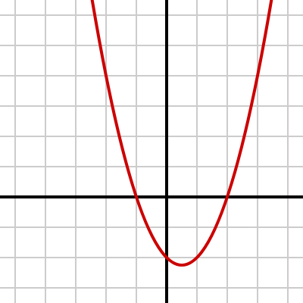
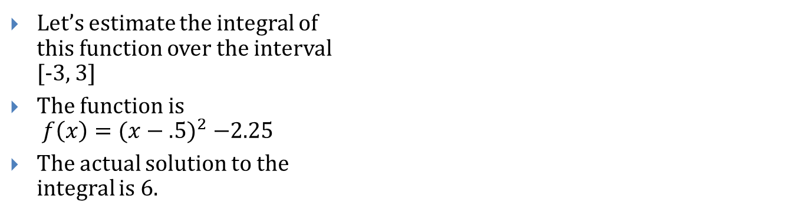
Monte Carlo Integration (7/8)
Let’s estimate the integral of this function over the interval [-3, 3]
The function is $f\left(x\right)={(x−.5)}^{2} −2.25$
The actual solution to the integral is 6.

Slide 20
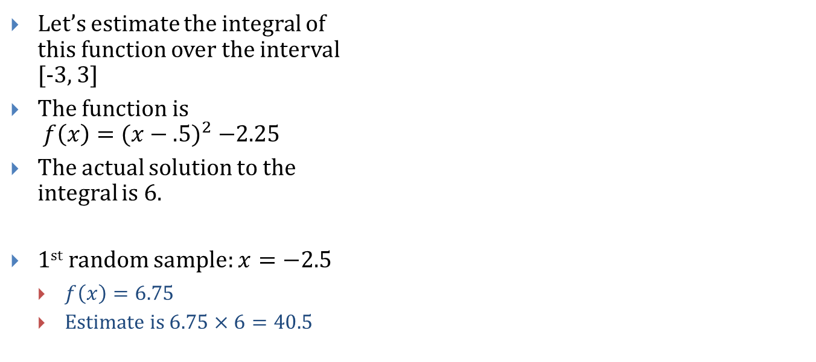
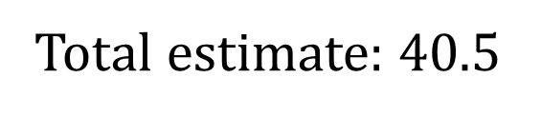
Monte Carlo Integration (7/8)
Let’s estimate the integral of this function over the interval [-3, 3]
The function is $f\left(x\right)={(x−.5)}^{2} −2.25$
The actual solution to the integral is 6.
1st random sample: $x=−2.5$
$f\left(x\right)=6.75$
Estimate is $6.75×6=40.5$
Total estimate: $40.5$

Slide 21
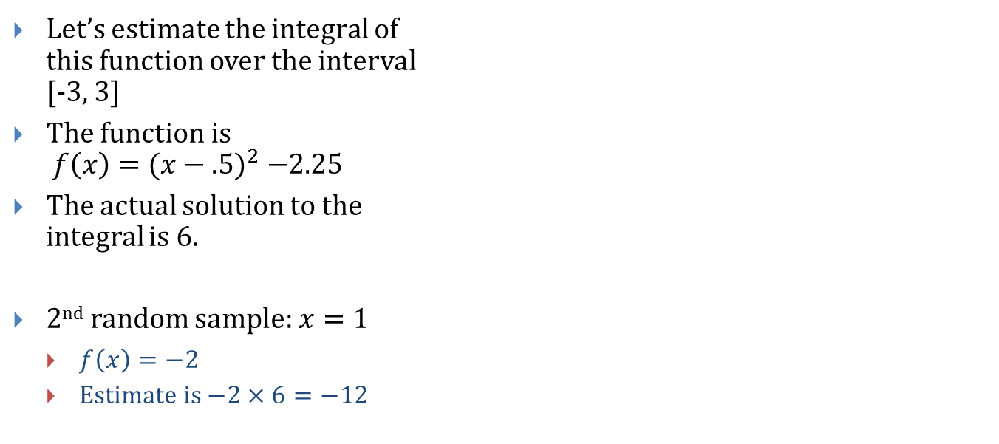
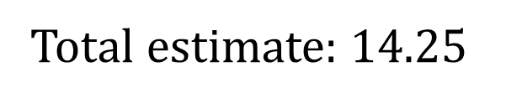
Monte Carlo Integration (7/8)
Let’s estimate the integral of this function over the interval [-3, 3]
The function is $f\left(x\right)={(x−.5)}^{2} −2.25$
The actual solution to the integral is 6.
2nd random sample: $x=1$
$f\left(x\right)=−2$
Estimate is $−2×6=−12$
Total estimate: $14.25$
Average of 40.5 and -12

Slide 22
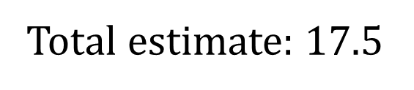
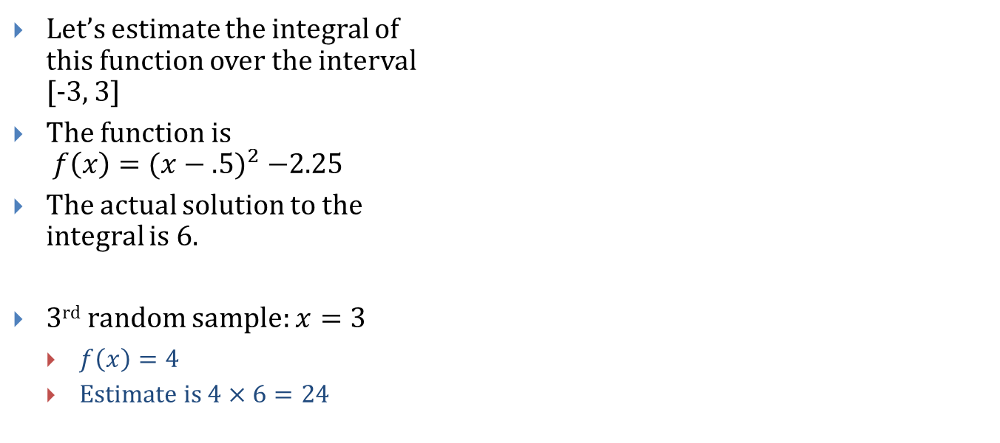
Monte Carlo Integration (7/8)
Let’s estimate the integral of this function over the interval [-3, 3]
The function is $f\left(x\right)={(x−.5)}^{2} −2.25$
The actual solution to the integral is 6.
3rd random sample: $x=3$
$f\left(x\right)=4$
Estimate is $4×6=24$
Total estimate: $17.5$
Average of 40.5 and -12 and 24

Slide 23

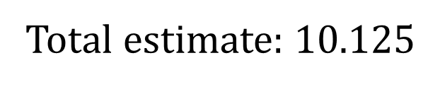
Monte Carlo Integration (7/8)
Let’s estimate the integral of this function over the interval [-3, 3]
The function is $f\left(x\right)={(x−.5)}^{2} −2.25$
The actual solution to the integral is 6.
4th random sample: $x=0$
$f\left(x\right)=−2$
Estimate is $−2×6=−12$
Total estimate: $10.125$
Average of 40.5 and -12 and 24 and -12

Slide 24
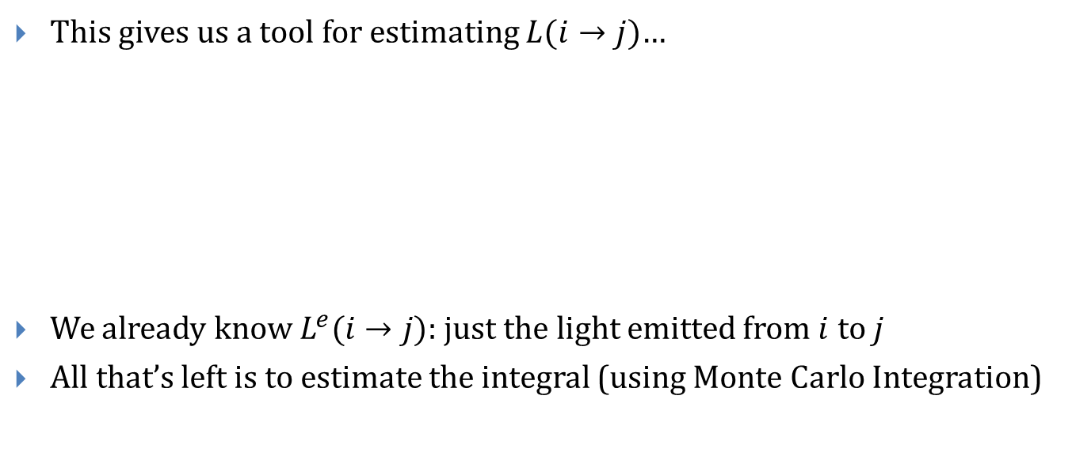
Monte Carlo Integration (8/8)
This gives us a tool for estimating $L(i→j)$…
We already know $L^{e}(i→j)$: just the light emitted from $i$ to $j$
All that’s left is to estimate the integral (using Monte Carlo Integration)

Slide 25
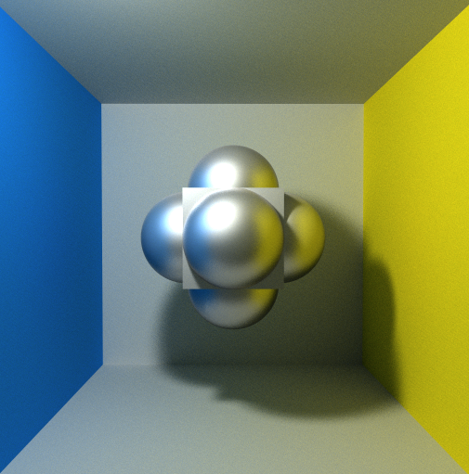
Path Tracing
By Kajiya in Rendering Equation paper, 1986
Uses Monte Carlo integration to approximate the light reaching each pixel
Pros
Robust: handles many lighting phenomena
Correct: always converges to exact solution
Cons
Takes many samples to converge to correct result
Used to create ‘correct’ reference images, but faster techniques often used in practice
Screenshot of real-time path tracing demo by former TA Evan Wallace
http://madebyevan.com/webgl-path-tracing/

Slide 26
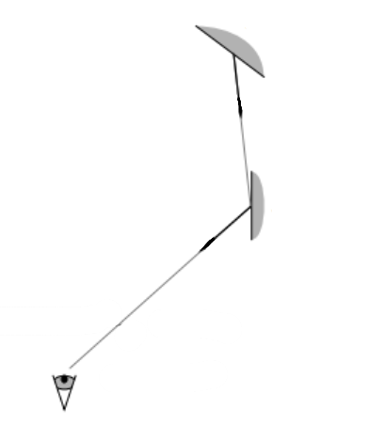
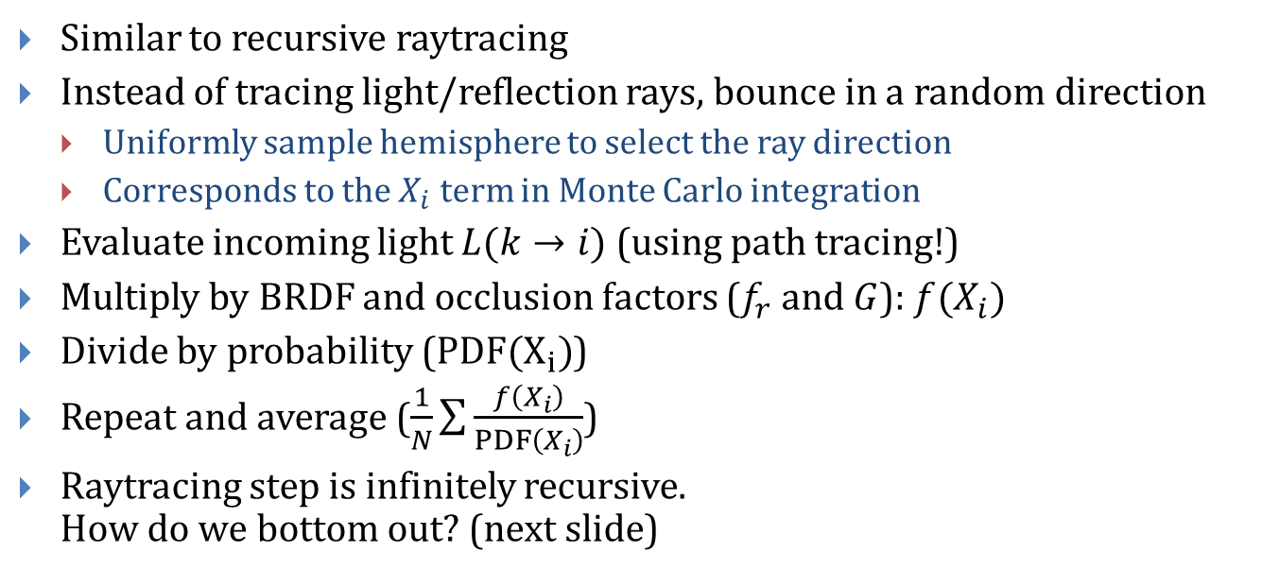
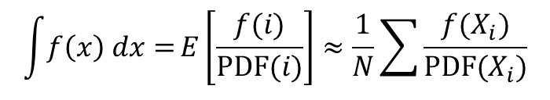
A Naïve Path Tracer (1/3)
$$\int{f\left(x\right) dx=}E\left[\frac{f(i)}{PDF(i)}\right]≈\frac{1}{N}\sum{\frac{f(X_{i})}{PDF(X_{i})}}$$
Similar to recursive raytracing
Instead of tracing light/reflection rays, bounce in a random direction
Uniformly sample hemisphere to select the ray direction
Corresponds to the $X_{i}$ term in Monte Carlo integration
Evaluate incoming light $L(k→i)$ (using path tracing!)
Multiply by BRDF and occlusion factors ($f_{r}$ and $G$): $f(X_{i})$
Divide by probability ($PDF(X_{i})$)
Repeat and average ($\frac{1}{N}\sum{\frac{f\left(X_{i}\right)}{PDF\left(X_{i}\right)}}$)
Raytracing step is infinitely recursive. How do we bottom out? (next slide)
(diagram modified from [Lafortune, Willems])

Slide 27
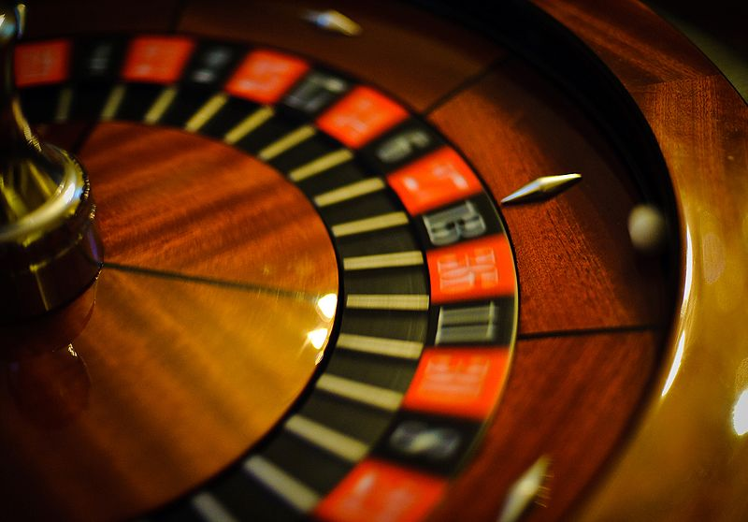
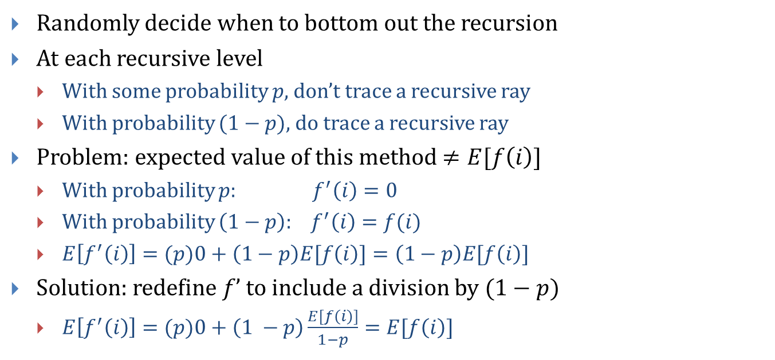
Russian Roulette
Randomly decide when to bottom out the recursion
At each recursive level
With some probability $p$, don’t trace a recursive ray
With probability $(1−p)$, do trace a recursive ray
Problem: expected value of this method $≠E[f\left(i\right)]$
With probability $p:$ $f^{′}\left(i\right)=0$
With probability $\left(1−p\right):$ $f^{′}\left(i\right)=f(i)$
$E\left[f^{′}\left(i\right)\right]=(p)0+\left(1−p\right)E[f\left(i\right)]=\left(1−p\right)E[f\left(i\right)]$
Solution: redefine $f’$ to include a division by $(1−p)$
$E\left[f^{′}\left(i\right)\right]=(p)0+\left(1 −p\right)\frac{E[f\left(i\right)]}{1−p}=E[f\left(i\right)]$
continental roulette

Slide 28
A Naïve Path Tracer (2/3)
L(i, j):
L_reflected := 0
p_RR := russian roulette probability constant
if random(0, 1) > p_RR:
k := sample direction uniformly on hemisphere and trace ray
L_reflected := ((L(k, i) * fr(k, i, j) * G(k, i)) / (1 – p_RR) / PDF(k)
return L_e(i, j) + L_reflected
Russian Roulette Probability
Monte Carlo Probability

Slide 29
A Naïve Path Tracer (3/3)
Main:
N := a large constant for (n := 0; n < N; ++n)
for (y := 0; y < height; ++y)
for (x := 0; x < width; ++x)
pt := point eye ray intersects scene
pixel[x, y] += L(pt, eye) / N

Slide 30
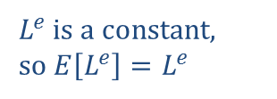
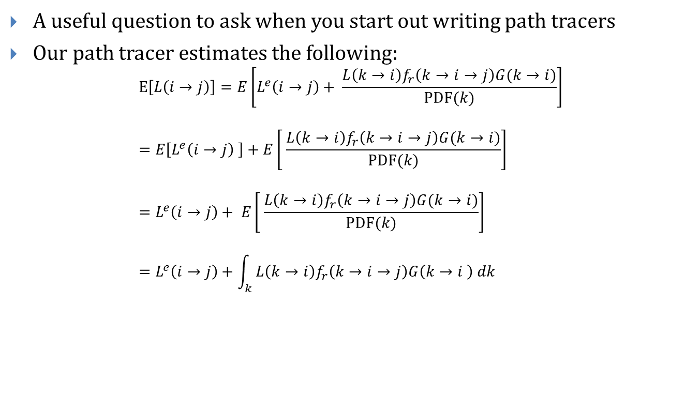
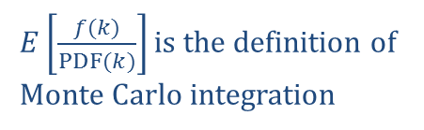
Is This Correct?
A useful question to ask when you start out writing path tracers
Our path tracer estimates the following: $E\left[L\left(i→j\right)\right]=E\left[L^{e}\left(i→j\right)+ \frac{L\left(k→i\right)f_{r}\left(k→i→j\right)G(k→i)}{PDF(k)}\right]$ $=E\left[L^{e}\left(i→j\right) \right]+E\left[ \frac{L\left(k→i\right)f_{r}\left(k→i→j\right)G(k→i)}{PDF(k)}\right]$ $=L^{e}\left(i→j\right)+ E\left[ \frac{L\left(k→i\right)f_{r}\left(k→i→j\right)G(k→i)}{PDF(k)}\right]$ $=L^{e}\left(i→j\right)+\int_{k}{ L\left(k→i\right)f_{r}\left(k→i→j\right)G\left(k→i \right) dk}$
Russian roulette omitted for brevity
$L^{e}$ is a constant, so $E\left[L^{e}\right]=L^{e}$
$E\left[\frac{f(k)}{PDF(k)}\right]$ is the definition of Monte Carlo integration
Q.E.D.

Slide 31
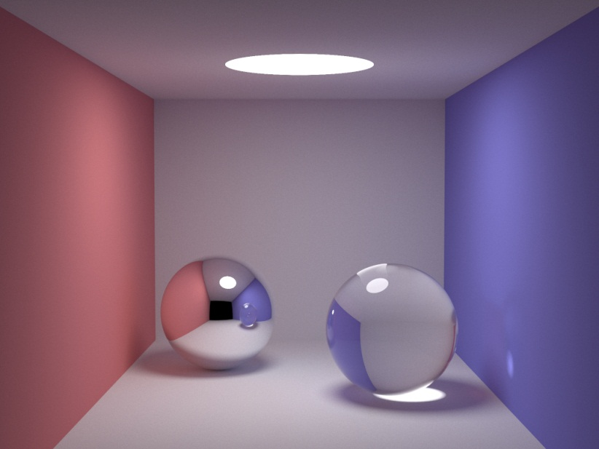
Progressive Refinement
Visualization of scene as more and more samples are averaged
Screenshots from “smallpt” path tracer by Kevin Beason
(in 99 lines of C++!)
http://www.kevinbeason.com/smallpt/
Final image:

Slide 32
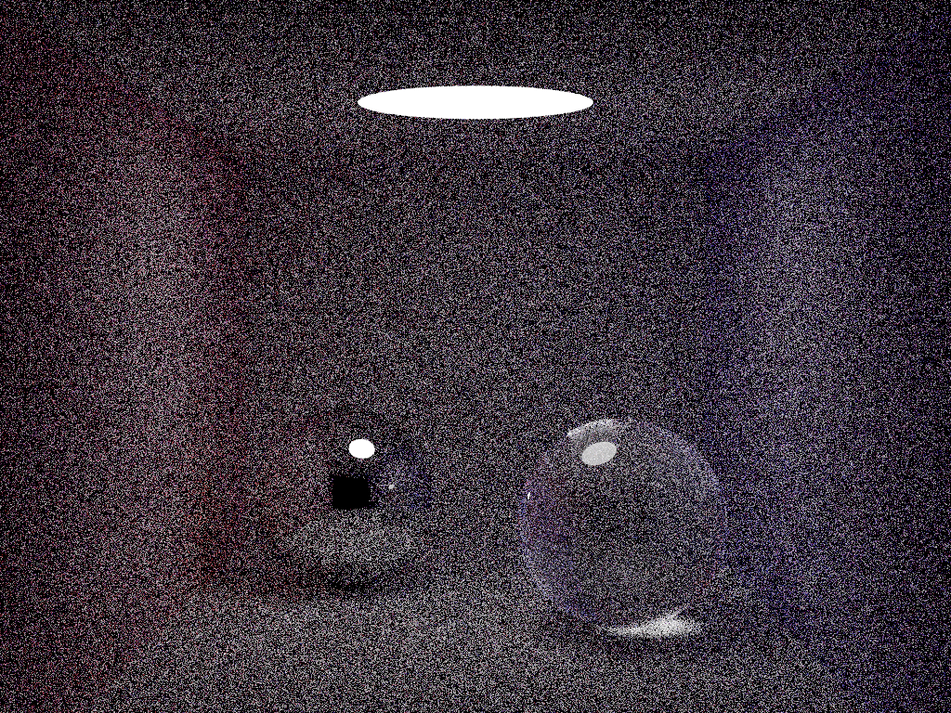
Progressive Refinement
8 samples per pixel in 13 seconds

Slide 33
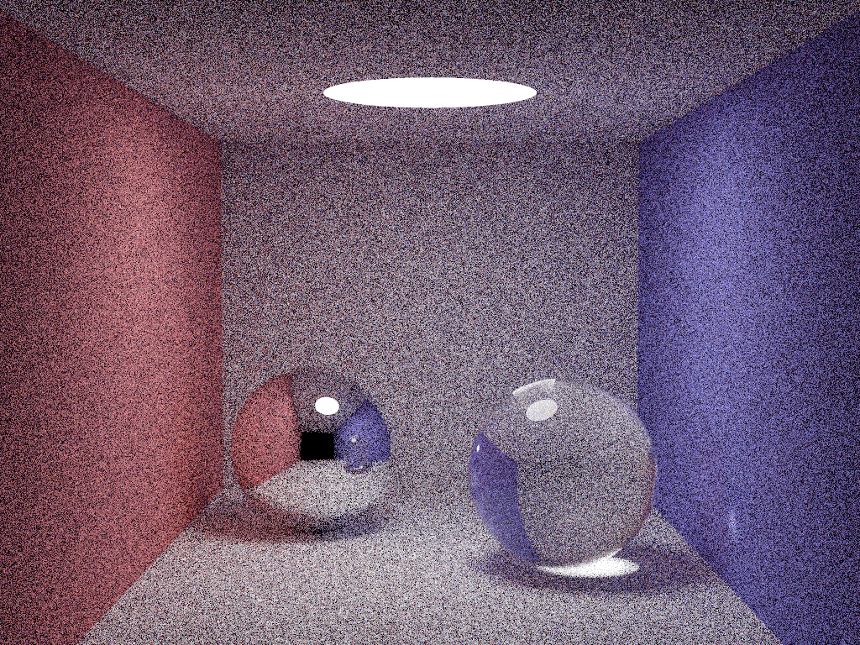
Progressive Refinement
40 samples per pixel in 63 seconds

Slide 34
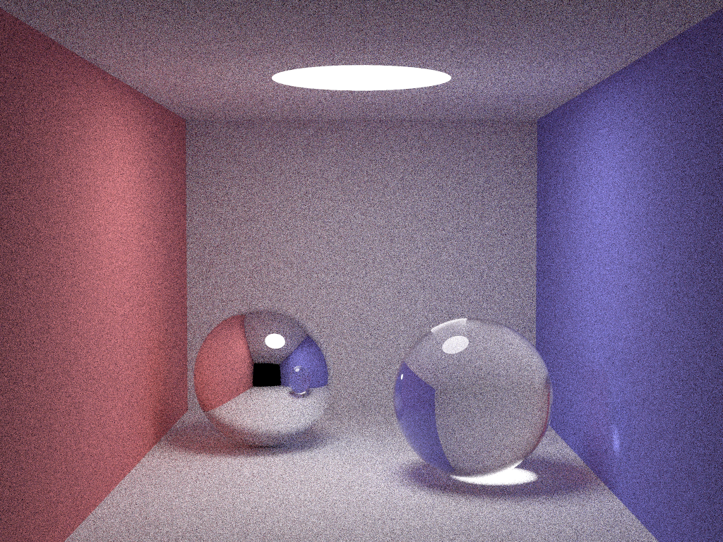
Progressive Refinement
200 samples per pixel in 5 minutes

Slide 35

Progressive Refinement
1000 samples per pixel in 25 minutes

Slide 36

Progressive Refinement
5000 samples per pixel in 124 minutes

Slide 37
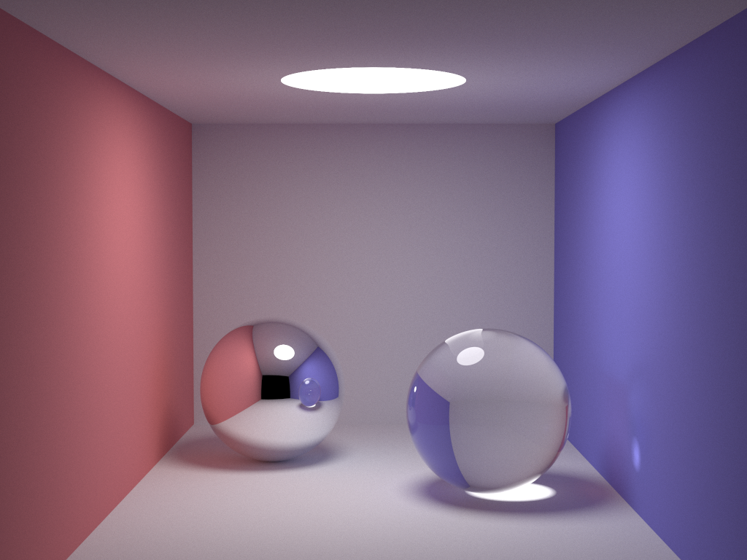
Progressive Refinement
25,000 samples per pixel in 10.3 hours

Slide 38
How Quickly Does This Converge?
Slowly
Low chance of randomly shooting a ray towards a light, for example
Most rays gather little to no light
Need to average many samples to get good results
Need to wait a long time
How can we modify the algorithm to converge more quickly?

Slide 39
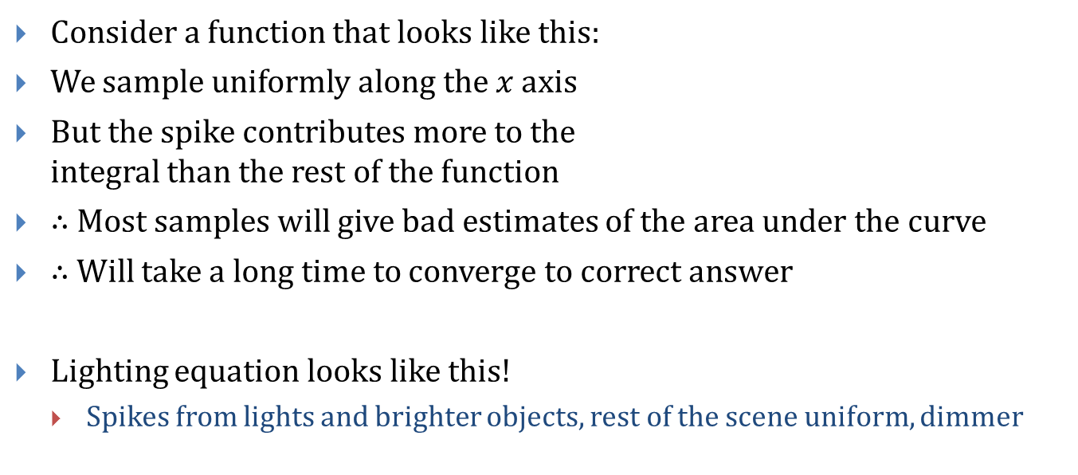
Importance Sampling (1/2)
Consider a function that looks like this:
We sample uniformly along the $x$ axis
But the spike contributes more to the integral than the rest of the function
$∴$ Most samples will give bad estimates of the area under the curve
$∴$ Will take a long time to converge to correct answer
Lighting equation looks like this!
Spikes from lights and brighter objects, rest of the scene uniform, dimmer

Slide 40
Importance Sampling (2/2)
Fix by sampling more often near the spikes in the function
Called Importance Sampling
In terms of Monte Carlo rendering
Recursive ray direction chosen by sampling random point on hemisphere
Prefer rays that point towards light sources
Prefer rays that point along specular highlight spike in BRDF
Many other heuristics
Makes PDF (and, thus, PDF(k) term) more complex

Slide 41
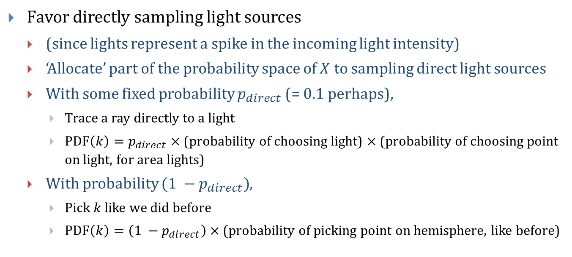
Some Importance Sampling Strategies (1/2)
Favor directly sampling light sources
(since lights represent a spike in the incoming light intensity)
‘Allocate’ part of the probability space of $X$ to sampling direct light sources
With some fixed probability $p_{direct}$ (= 0.1 perhaps),
Trace a ray directly to a light
$\operatorname{PDF}\left(k\right)=p_{direct}×$ (probability of choosing light) $×$ (probability of choosing point on light, for area lights)
With probability $(1 −p_{direct})$,
Pick $k$ like we did before
$\operatorname{PDF}\left(k\right)=\left(1 −p_{direct}\right)×$ (probability of picking point on hemisphere, like before)

Slide 42
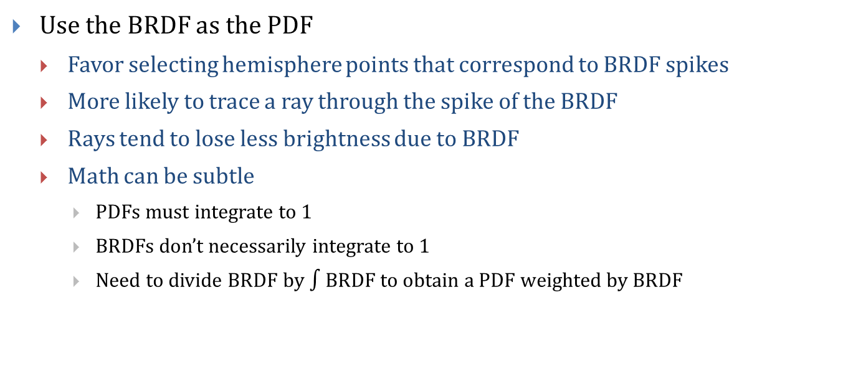
Some Importance Sampling Strategies (2/2)
Use the BRDF as the PDF
Favor selecting hemisphere points that correspond to BRDF spikes
More likely to trace a ray through the spike of the BRDF
Rays tend to lose less brightness due to BRDF
Math can be subtle
PDFs must integrate to 1
BRDFs don’t necessarily integrate to 1
Need to divide BRDF by $∫$BRDF to obtain a PDF weighted by BRDF

Slide 43
Bidirectional Path Tracing (1/2)
Much research into Monte Carlo techniques that converge quickly
Bidirectional Path Tracing (BDPT)
Extension of normal path tracing, by Lafortune and Willems, 1996
Like path tracing, converges to correct evaluation of rendering equation
Converges faster than conventional path tracing
Core idea: forward map and back map (meet in the middle)
This isn’t the last time we’ll see this idea

Slide 44
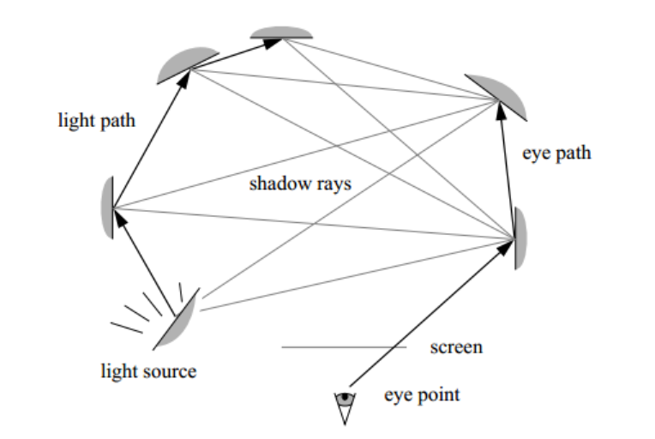
Bidirectional Path Tracing (2/2)
First, trace a random path from a light source through the scene
Second, trace a random path from the eye through the scene
Finally, send luminance from each hop in the light path to each hop in the eye path
Pro: every hop gets direct lighting contribution
Con: computing the probability to divide by is trickier
3
1
2
Schematic diagram from original paper [Lafortune, Willems]

Slide 45
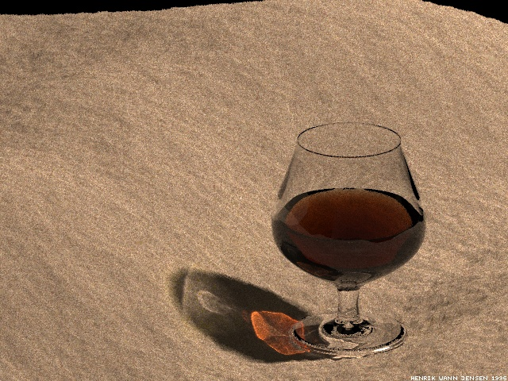
Photon Mapping
Invented by Henrik Wann Jensen, 1995
Extension of recursive raytracing
Handles diffuse inter-object reflection and caustics
Idea: store all indirect illumination in a three-dimensional photon map
A photon contains information about intensity, color, direction of a packet of light
A photon map contains photons organized in 3D space (usually a kd-tree)
Photons are sampled during raytracing to collect inter-object reflection
Image: Henrik Wann Jensen

Slide 46

Photon Mapping: Supported Lighting Effects
Diffuse Color
Bleeding
Soft Shadows
Caustics
Specular Reflection/Refraction
Image credit: Alex Rice

Slide 47


Generating the Photon Map
Generate photon map by shooting photons into scene, randomly bouncing around scene (like path tracing)
While [not enough photons in photon map]
Shoot a photon from a light into the scene
Where the photon collides
Store the photon in the photon map at that point (light intensities, direction, etc)
Determine whether photon is reflected or absorbed (Russian Roulette)
If reflected, attenuate photon energy according to BRDF and shoot photon back into scene
Repeat until photon absorbed
Raytraced image and corresponding photon map from http://graphics.stanford.edu/courses/cs348b-00/course8.pdf

Slide 48

Rendering with Photon Maps
Raytrace normally
To compute lighting at a point
Cast shadow ray, compute direct lighting, cast reflection ray, etc
Sample photon map
For some fixed $k$
Find the $k$ photons in the photon map closest to the intersection point
Compute the illumination received from each of the $k$ photons
Sum illumination from
Direct lighting
Perfect specular reflection (from raytracing)
Indirect lighting (from photon map)

Slide 49

Caustic Maps
Since photons are shot into scene randomly, some areas may be under-represented
Especially problematic with caustics
Solution
Split photon map into two photon maps
Store ‘general’ photons in one, caustic photons in the other
Caustic photon: any photon that passed through at least one specular reflection or refraction, before finally landing on a diffuse surface
Enforce a minimum size on each photon map
Sample both when rendering (sum contributions)

Slide 50
Convergence Characteristics
An unbiased algorithm produces the exact solution to the rendering equation when infinity runs (with any fixed number of samples) are averaged together
A consistent algorithm produces the exact solution when the sample size approaches infinity
Photon mapping is biased but consistent
If the photon map contained a single photon, approximation of indirect lighting would be non-existent. Wrong result no matter how many passes.
If the photon map contained infinity photons, would match rendering equation. Intuitively, shooting infinity photons simulates nature.
Large photon maps give good results, converge faster than path tracers

Slide 51

Metropolis Light Transport (MLT) (1/2)
Another Monte Carlo rendering algorithm
Able to render difficult scenes quickly
Notorious for being difficult to implement correctly
Uses Metropolis-Hastings Sampling
Metropolis, Rosenbluth, Rosenbluth, Teller, and Teller, 1953
A form of importance sampling
Samples chosen so that distribution eventually proportional to the function being integrated
Scene entirely lit from a light behind the door.

Slide 52

Metropolis Light Transport (MLT) (2/2)
Algorithm published by Eric Veach, Leonidas Guibas, 1997
Conceptually: $Final image=\int_{P}{(Contribution of a single path)}$
Where P is the space of all possible light paths through the scene
Integrate over all light paths from a light to the camera
Reformulates Kajiya rendering equation as a pure integral
MLT amortizes costs of finding these paths
After algorithm finds a successful path, high probability of perturbing that path locally
Perturbed path also likely to contribute to image

Slide 53
Interested in Learning More?
Chapters 30-32 in the book discuss several of these techniques
CS224 teaches them!
Shameless plug!
:D

